Slide 1
Capstone Presentation
Alexander Zecevic u3244749
Wednesday 2:30pm

Slide 2
Table of contents
1: Problem statement
2: Data introduction
3 - 9: EDA tests
10: Data modeling
11: deployment

Slide 3

Problem statement
Using various python libraries to perform exploratory data analysis on a given dataset.

Slide 4
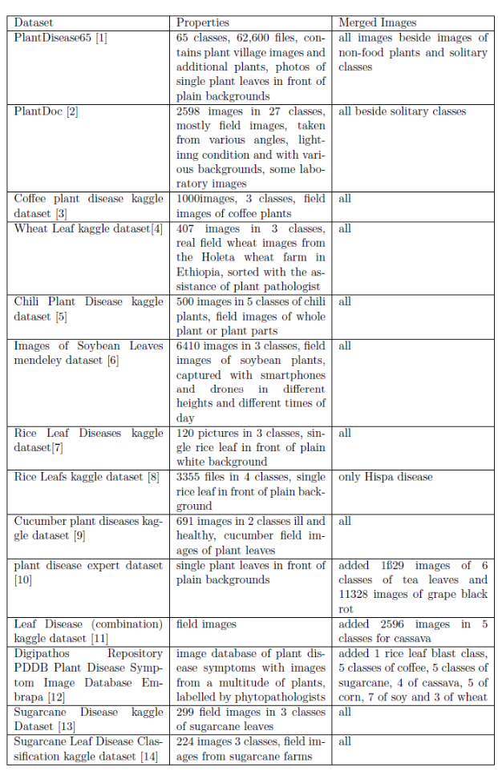
About my dataset
A homologated dataset of several different datasets relating to the classification of plant disease.
76,000 images
Totals 19GB

Slide 5
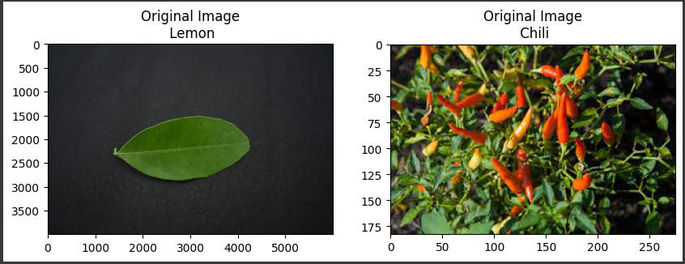
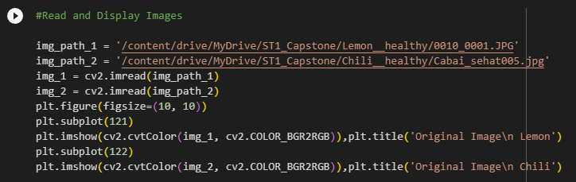
First test
Reading file paths and displaying images.
File path is read from google drive.
The two images used for testing are from the classes Lemon_healthy and Chili_healthy.

Slide 6
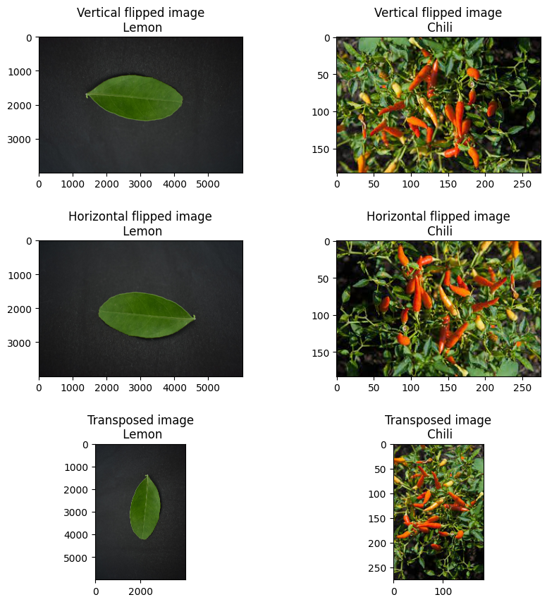
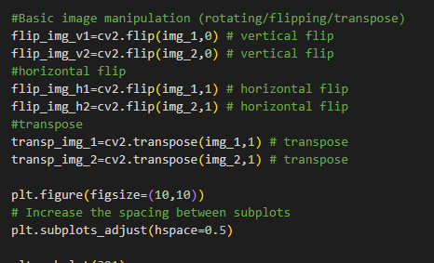
Second Test
This second test builds on the first by reading the file paths of the images and displaying the images in different orientations. This test shows how the program will interpret images when they have been geometrical manipulated

Slide 7

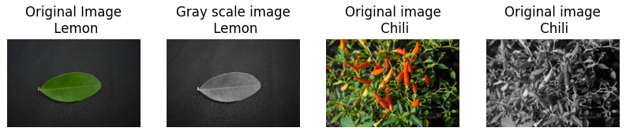
Third test
Similar to the second, the third test is designed to manipulate the images to see how to program interprets the image. In this case, the colour space has been shifted from RGB to grey.

Slide 8
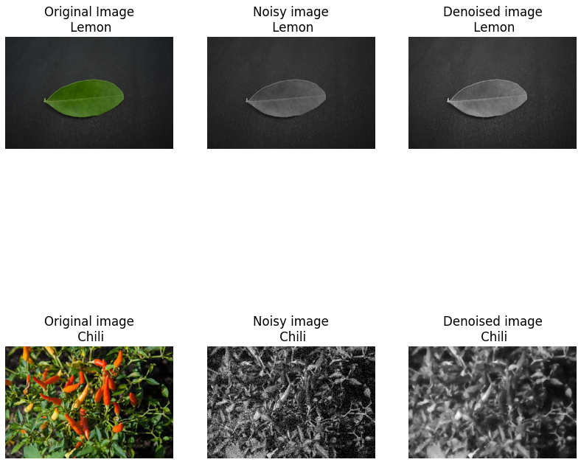
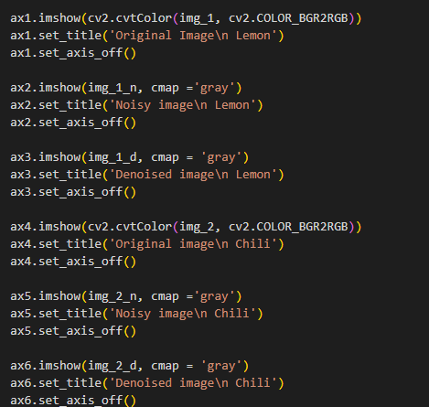
Fourth test
The fourth test was designed to reduce the quality of the images to see how the program interprets the image.

Slide 9
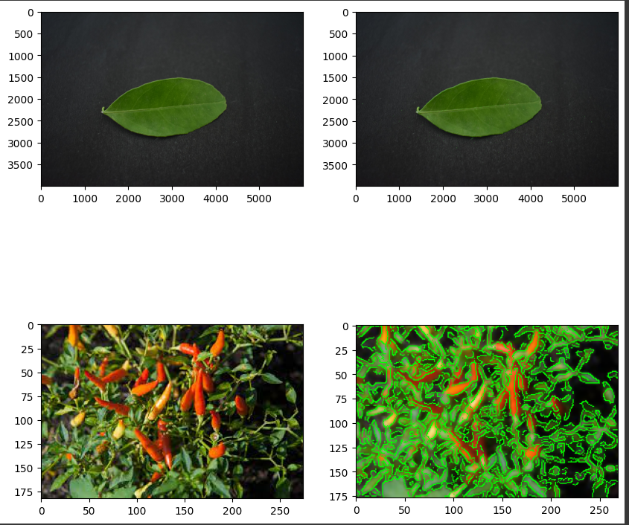
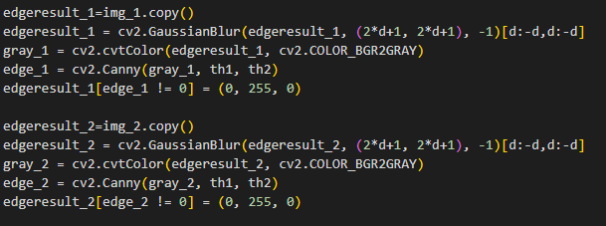
Fifth test
The final stage is using canny edge detection to draw on the edges visible to the program. This can be used to determine edge patterns within an image and make it easier to tell the classes apart. Can also be applied to manipulated images to see if the edges match to be able to determine image class.

Slide 10
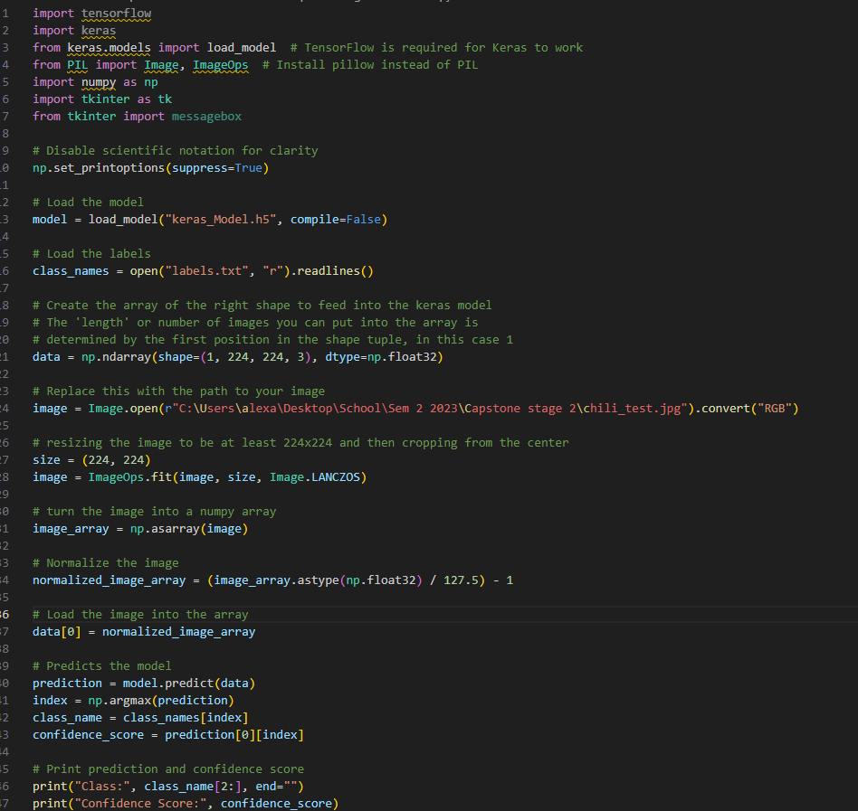

Data model (PDA)
Using teachable machine, a data model was created that is able to take an input image and then display what class it believes it to be a part of as well as displaying a confidence score.

Slide 11
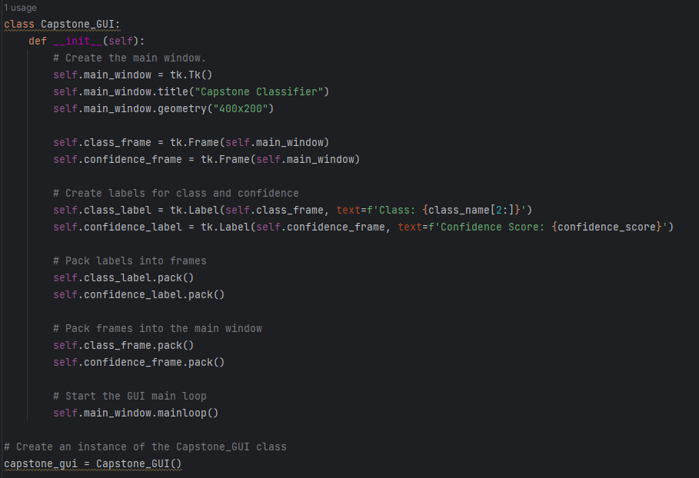
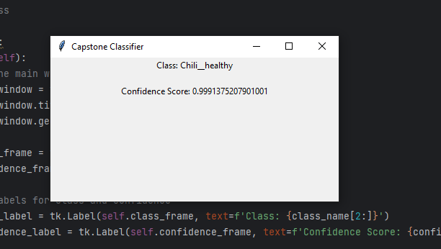
GUI
In addition to the code for the data model, a simple GUI was created to display the class_name and confidence_score variables. More features will be added to the GUI as it is a work in progress. However in its current state the GUI runs and displays the information.

Slide 12
Thank you for listening

